Slide 1

University of California, San Francisco ClinicalTrials.gov Registration User’s Guide
Updated: December 2025

Slide 2
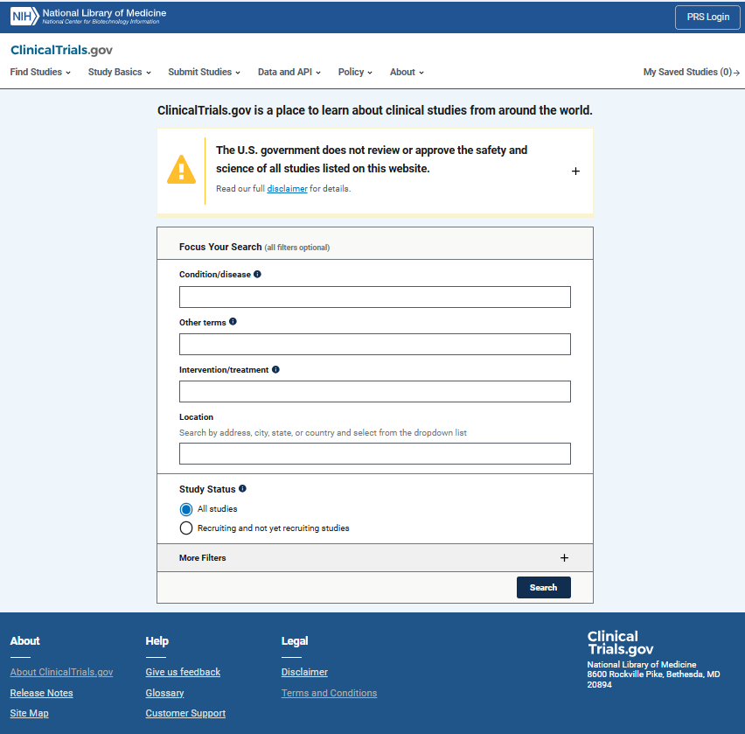
Public Site
URL: Home | ClinicalTrials.gov
Notes:
ClinicalTrials.gov provides patients, their family members, health care professionals, researchers, and the public with easy access to information on publicly and privately supported clinical studies on a wide range of diseases and conditions. ClinicalTrials.gov was created as a result of the Food and Drug Administration Modernization Act of 1997 (FDAMA). The ClinicalTrials.gov registration requirements were expanded after Congress passed the FDA Amendments Act of 2007 (FDAAA).
FDAAA 801 requires registration of studies meeting the definition of an Applicable Clinical Trial (ACT) on ClinicalTrials.gov. The law also requires the submission of results for ACTs.
In 2016, HHS issued the Final Rule for Clinical Trials Registration and Results Information Submission (42 CFR Part 11), clarifying and expanding the registration and results information submission requirements of FDAAA 801.
The U.S. National Institutes of Health (NIH) issued a final policy (NOT-OD-16-149) establishing the expectation that every clinical trial funded in whole or in part by NIH must be registered on ClinicalTrials.gov and must report results.

Slide 3
Tips and Recommendations for Registration
Do not use first or second person. Replace “I” and “we” with “the investigator”; replace “you” with “participants”
Typos and spelling errors are not acceptable
Define all acronyms when they first appear
Use "Notes" provided by PRS system to guide you
The notes are suggestions/reminders and are not mandatory
The Draft Receipt function provides a copy of your record as it appears in PRS
Notes:
ClinicalTrials.gov study records are created using a web-based data entry system known as the Protocol Registration and Results System (PRS). To be assigned a National Clinical Trial (NCT#) Identifier and registered in the public ClinicalTrials.gov database, a study record must meet the standards set by ClinicalTrials.gov PRS staff reviewers.
This document provides institution-specific guidance for investigators at the University of California, San Francisco (UCSF) on how to initiate a new study record.

Slide 4
Validation Messages
As you enter information, system validation (error, warning and note) messages may appear and disappear.
Start by entering information for all required data elements.
Note that some data elements are required, while others are conditionally required (based on information entered for other data elements).
Finish by addressing all remaining validation messages.
Complete all required fields before checking/stressing on validation.

Slide 5
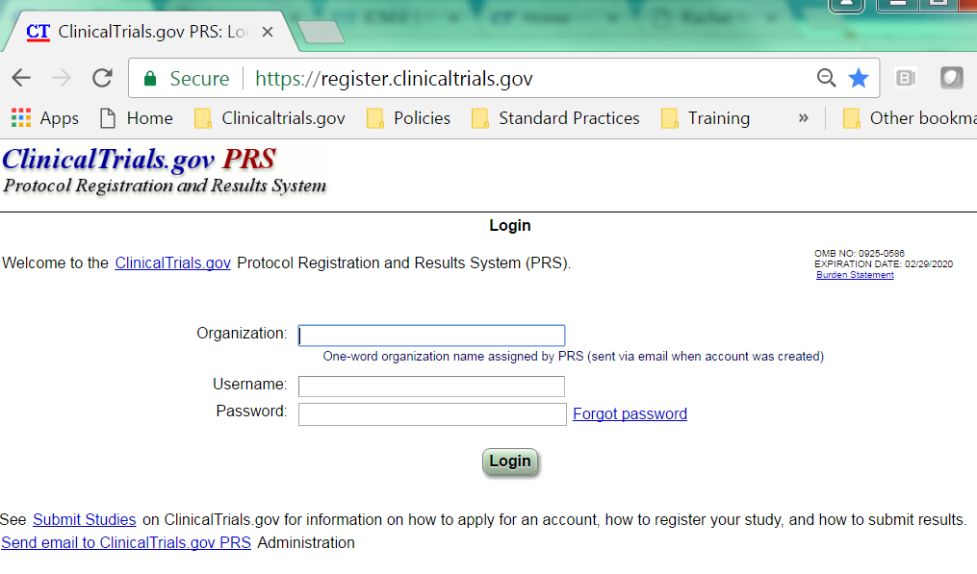
Protocol Registration and Results System (PRS)
Data entry site: ClinicalTrials.gov PRS: Login
Organization Name:
UCaliforniaSF
To obtain a new ClinicalTrials.gov user account, please contact the UCSF ClinicalTrials.gov Regulatory Support Team at CT.gov@ucsf.edu
Notes:
Protocol Registration and Results System (PRS) User Accounts: At UCSF, the policy is to create and maintain a study record under the ClinicalTrials.gov Protocol Registration and Results System (PRS) user account of the Principal Investigator on the IRB application. This means that PRS accounts will be created for PIs, and PIs may share their PRS login credentials with staff, delegating the responsibility of creating and maintaining study records to research support staff.
The UCSF ClinicalTrials.gov Regulatory Support Team within the Office of Ethics and Compliance (OEC) provides support to UCSF clinical researchers with ClinicalTrials.gov submissions and reporting. Contact CT.gov@ucsf.edu for assistance.
If you are a researcher affiliated with the Helen Diller Family Comprehensive Cancer Center, contact the HDFCCC Data Integrity and Research Compliance Team for assistance with your ClinicalTrials.gov study records at HDFCCCresearchcompliance@ucsf.edu.

Slide 6
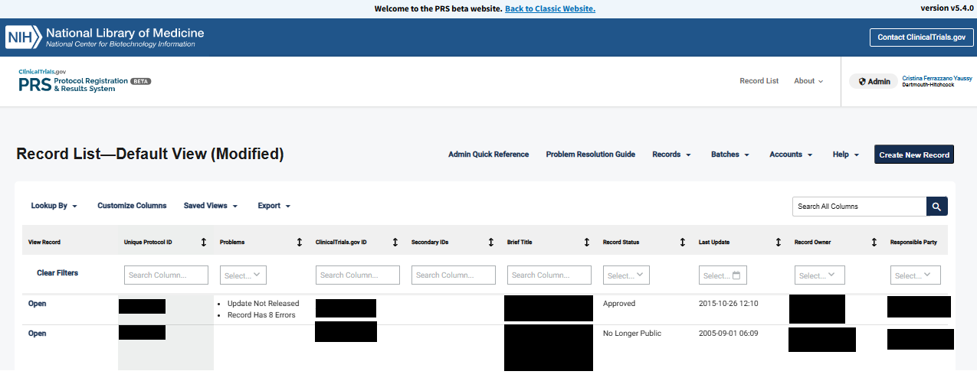
Creating a New Record (Study)
The system flags records with problems to be addressed
To create a new record,
click the Create New Record button
Notes:
All Clinical Trials (all phases and intervention types) must be registered before enrolling the first participant according to the UCSF Clinical Trials Registration & Reporting Policy: https://policies.ucsf.edu/policy/400-22

Slide 7
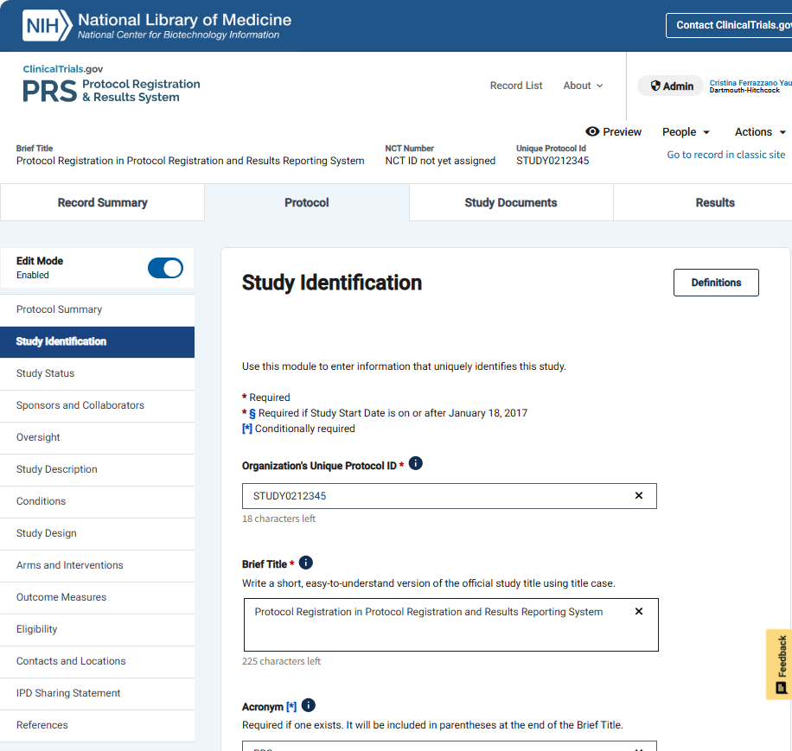
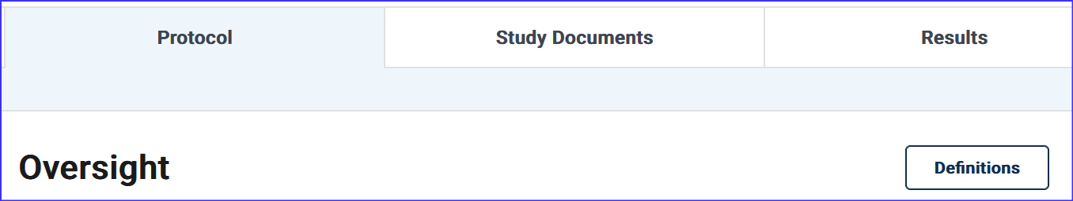

Study Identification Section
Click the Definitions link for all definitions related to each Section
Click on this icon for information specific to the data element.

Slide 8
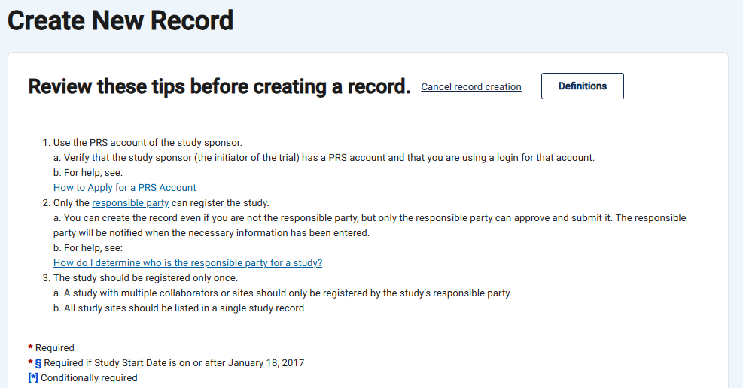
Create new record
The Definitions link contains the meaning of terms and useful information about field lengths
At UCSF, the Responsible Party is designated as follows:
“University of California, San Francisco” should be listed as the Sponsor and Responsible Party in most cases unless the Principal Investigator (PI) holds an Investigational New Drug Application (IND) or an Investigational Device Exemption (IDE) for the Clinical Trial.
If the PI holds an IND/IDE for the Clinical Trial (as the “Sponsor-Investigator”), the PI should be listed as the Sponsor and Responsible Party.
Not all fields are required.
Guidance for Study Identification continues on next slide

Slide 9
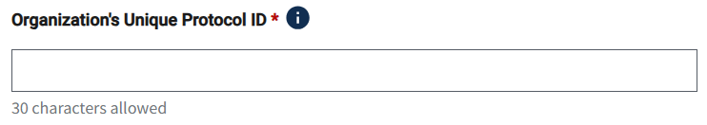
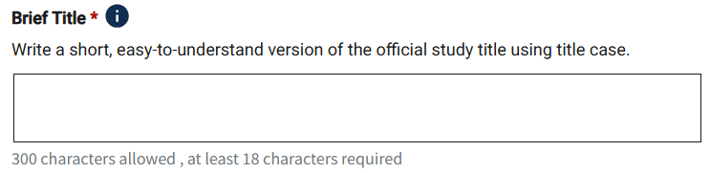
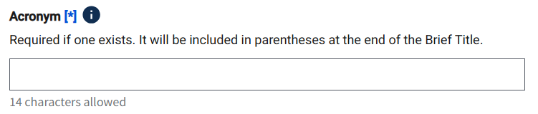
Study Identification
IRB Number*
*see note
This title will be displayed in search results on ClinicalTrials.gov
Guidance for Study Identification continues on next slide
Notes:
Unique Protocol ID: At UCSF, enter the Organization's Unique Protocol ID as follows:
For grant-funded projects, use the Sponsor-issued grant or award number
For industry-funded projects, use the Sponsor’s protocol ID number
For cancer center projects, the Helen Diller Family Comprehensive Cancer Center (HDFCCC) ID is assigned by the Protocol Review and Monitoring Committee (PRMC) as the unique protocol ID number
For all others, if no other unique identifier assigned by funder is available, use Institutional Review Board (IRB) study number (YY-XXXXX)

Slide 10
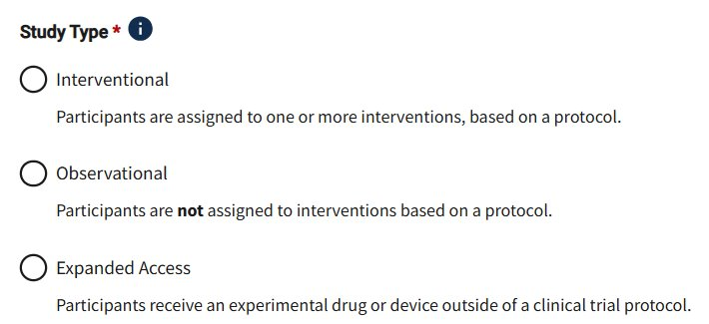
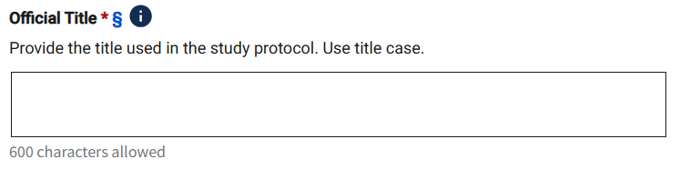
Study Identification: Study Type and Title
Expanded Access records should only be created by the product manufacturer
If "Observational" is selected, you will be prompted to indicate if the study is a Patient Registry
IRB Approved Long Title
Required by ICMJE; should be consistent with formal IRB title
Guidance for Study Identification continues on next slide

Slide 11
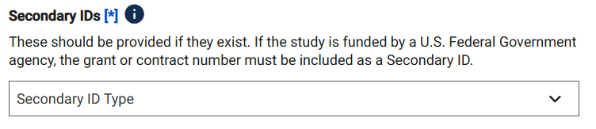

Study Identification: Secondary IDs
Include Funding Agency Identifiers
NOTE: If the clinical study is funded in whole or in part by a U.S. Federal Government agency, the complete grant or contract number must be submitted as a Secondary ID. NIH grants should have an activity code (3 or 4 numbers and letters, such as R01), institute code (2 letters), and a 6 digit serial number. They may have a dash (-) and suffix.
Click “Create Record” to create initial shell of record
Notes:
Any federal grant/funding number(s) must be listed as a “Secondary ID” in the study record.

Slide 12
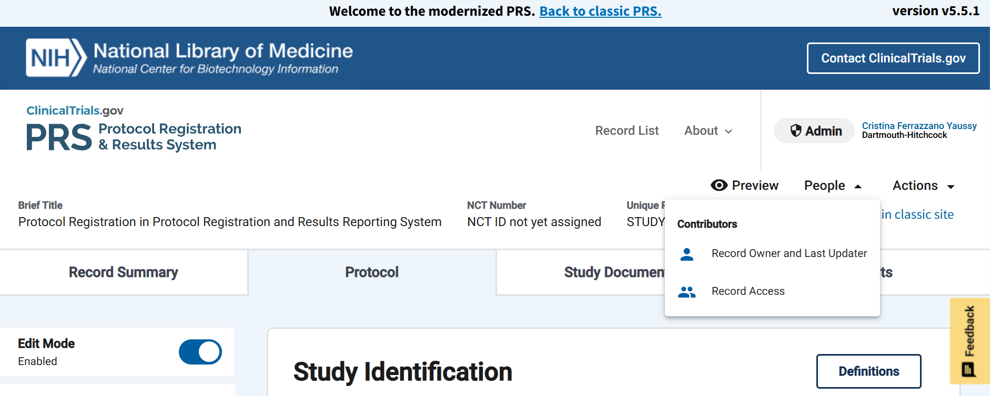
Granting Access to the Record
Click on “People” dropdown:
To view Record Owner and Last Updater
To add people to Record Access List
The Record Owner is a ClinicalTrials.gov account holder who is responsible for establishing and maintaining study records on ClinicalTrials.gov, and for addressing any problems with the records. At UCSF, the Principal Investigator (PI) of the study is the Record Owner for Investigator-Initiated Trials.

Slide 13
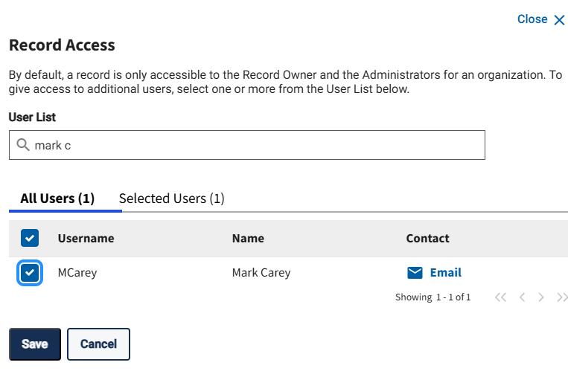
Record Access
Use search field to find additional investigators who will help mange and edit the record.
The Record Owner can do this.
The Record Owner (study PI) can share access with the co-PIs, as needed. The Record Owner is the primary contact for the record. Only an administrator can change the Record Owner.
The Record Owner is responsible for accuracy and veracity of the record, and for ensuring proper maintenance.
: "

Slide 14
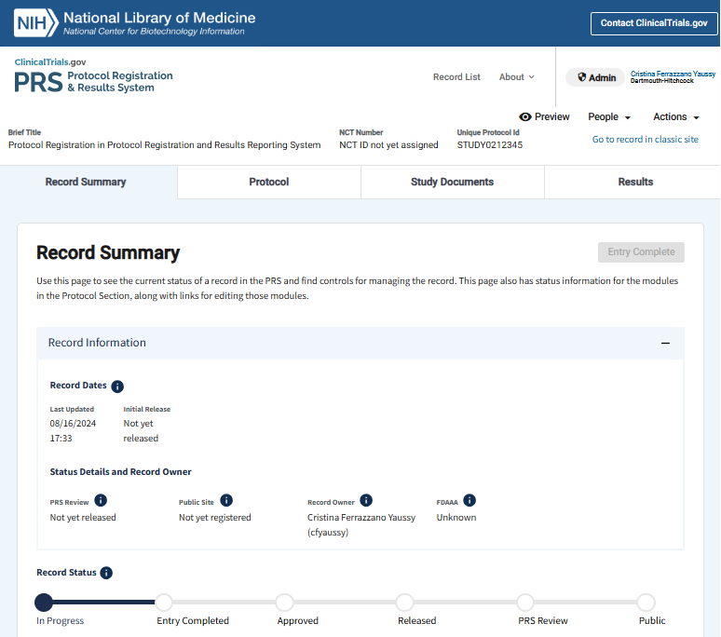
Record Summary
As you fill in more information, the Record Summary will show your progress.
Scroll down to see additional details and summary of required information

Slide 15
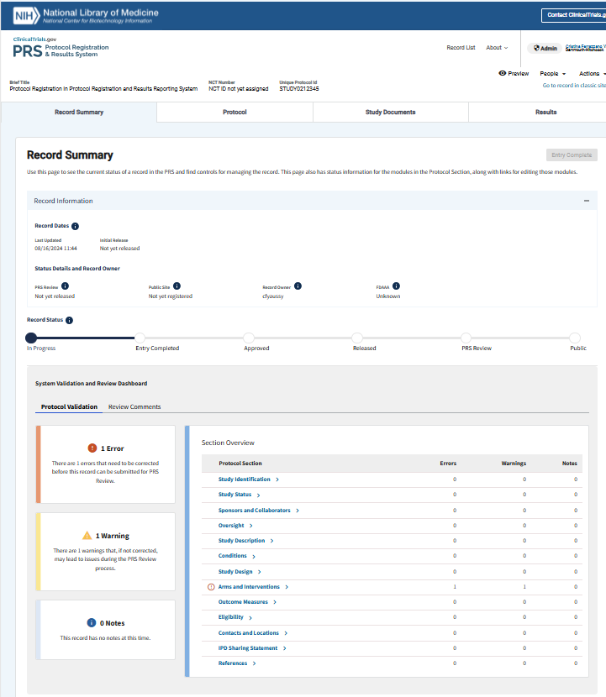
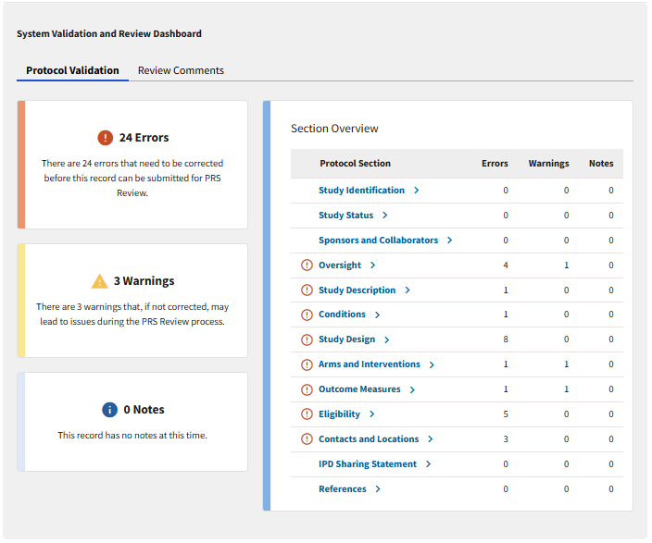
Sections names will take you to the respective sections

Slide 16
Edit Mode = Enabled
Navigate to "Protocol" to edit all sections
Click on the Section Name to edit information section by section
Click on the icon to learn about the requirements of each field.

Slide 17
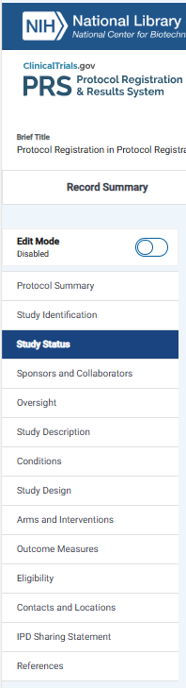
Study Status Section
Click the Definitions link for all definitions related to each Section
Click on this icon for information specific to the data element.

Slide 18
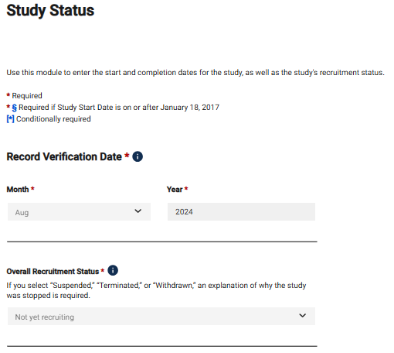
Study Status
Update Record Verification Date every time the record is updated and review for accuracy. This is how compliance with ongoing updates is tracked.
Only use “Active, not recruiting” if data are still being collected.
If data collection is complete, the status should be Completed or Terminated.
Guidance for Study Status continues on next slide
Notes:
Overall Recruitment Status: This field refers to participant contact and data collection, not data analysis or the status of the study with the IRB. The “active, not recruiting” status is defined as: “study is ongoing (i.e., patients are being treated or examined), but participants are not currently being recruited or enrolled.”
Completion Dates: These dates are VERY IMPORTANT, especially for FDA Applicable Clinical Trials (ACTs) and NIH-funded studies. They drive the timeline for results entry.

Slide 19
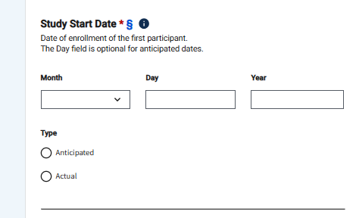
Study Status: Start Date
Select Anticipated for projected start dates
Select Actual once the enrollment date has occurred
Study Start Date
Enter the anticipated date that the study will start recruiting participants or the actual date that the first participant was enrolled.
Guidance for Study Status continues on next slide
Notes:
Overall Recruitment Status: This field refers to patient contact and data collection, not data analysis or the status of the study with the IRB. The “active, not recruiting” status is defined as: “study is ongoing (i.e., patients are being treated or examined), but participants are not currently being recruited or enrolled.”
Completion Dates: These dates are VERY IMPORTANT, especially for FDA Applicable Clinical Trials (ACTs) and NIH-funded studies. They drive the timeline for results entry.

Slide 20
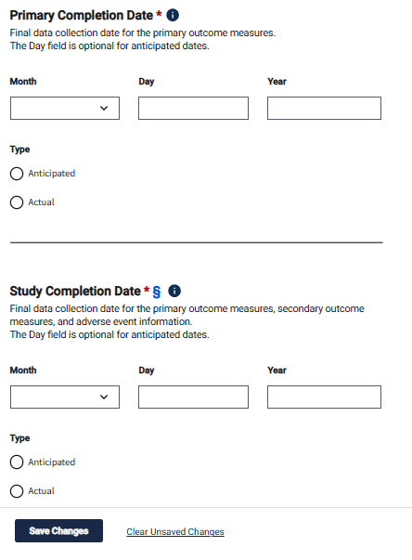
Primary and Study Completion Dates (1)
Completion Dates are based on data collection
They are NOT based on:
data analysis
database lock
publication
IRB closure
Select Anticipated for projections
Select Actual once the final data collection date has occurred for the primary outcome(s)
If you use these as Completion Dates, you may have LATE RESULTS
Select Anticipated for projections
Select Actual once the final data collection date has occurred for all prespecified outcomes and adverse events
Save button is at bottom of each section
Guidance for Study Status continues on next slide
Notes:
Completion Date definitions per ClinicalTrials.gov PRS (adapted from 42 CFR Part 11):
Primary Completion Date is the date that the final participant was examined or received an intervention for the purposes of final collection of data for the primary outcome measure(s).
Study Completion Date is the date the final participant was examined or received an intervention for purposes of final collection of data for the primary and secondary outcome measures and adverse events (for example, last participant’s last visit).
Important: both completion dates are determined by the final date data were collected from participants. IRB approval or closure dates, a manuscript publication date, or a data analysis completion date are not applicable here.

Slide 21
Primary and Study Completion Dates (2)
Remember:
Results for the primary outcome measure(s) are due within one year of the Primary Completion Date.
Results for the secondary outcome measures are due one year after the completion date for that outcome.
Notes:
Completion Date definitions per ClinicalTrials.gov PRS (adapted from 42 CFR Part 11):
Primary Completion Date is the date that the final participant was examined or received an intervention for the purposes of final collection of data for the primary outcome measure(s).
Study Completion Date is the date the final participant was examined or received an intervention for purposes of final collection of data for the primary and secondary outcome measures and adverse events (for example, last participant’s last visit).
Important: both completion dates are determined by the final date data were collected from participants. IRB approval or closure dates, a manuscript publication date, or a data analysis completion date are not applicable here.

Slide 22
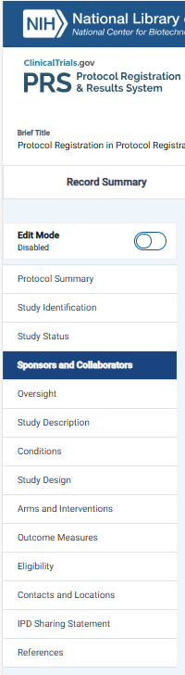
Sponsors and Collaborators Section
PRS ADMIN: Slides 24-26 should reflect your institutional practices. You may need to delete and/or modify them.
Click the Definitions link for all definitions related to each Section
Click on this icon for information specific to the data element.
Notes:
Responsible Party
The Responsible Party is responsible for verifying the accuracy of a study record and releasing it to ClinicalTrials.gov. At UCSF, the Responsible Party is designated as follows for Investigator-Initiated Trials:
“University of California, San Francisco” should be listed as the Sponsor and Responsible Party in most cases unless the Principal Investigator (PI) holds an Investigational New Drug Application (IND) or an Investigational Device Exemption (IDE) for the Clinical Trial.
If the PI holds an IND/IDE for the Clinical Trial (as the “Sponsor-Investigator”), the PI should be listed as the Sponsor and Responsible Party.
Sponsor
At UCSF, when an Investigator-Initiated Trial is conducted under an investigational new drug application (IND) or investigational device exemption (IDE), the IND or IDE holder is considered the sponsor. When an Investigator-Initiated Trial is not conducted under an IND or IDE, UCSF is considered the sponsor.

Slide 23
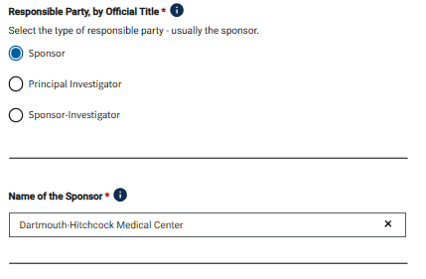
Responsible Party:
Requirements if Sponsor (UCSF) is Responsible Party
RESPONSIBLE PARTY:
Select Sponsor if study does NOT have an IND/IDE
University of California, San Francisco
This is the organization or individual responsible for conducting the study and data analyses. The sponsor does not necessarily fund the study.
Guidance for Sponsor and Collaborators continues on next slide
Notes:
Responsible Party
The Responsible Party is responsible for verifying the accuracy of a study record and releasing it to ClinicalTrials.gov. At UCSF, the Responsible Party is designated as follows for Investigator-Initiated Trials:
“University of California, San Francisco” should be listed as the Sponsor and Responsible Party in most cases unless the Principal Investigator (PI) holds an Investigational New Drug Application (IND) or an Investigational Device Exemption (IDE) for the Clinical Trial.
If the PI holds an IND/IDE for the Clinical Trial (as the “Sponsor-Investigator”), the PI should be listed as the Sponsor and Responsible Party.
Sponsor
At UCSF, when an Investigator-Initiated Trial is conducted under an investigational new drug application (IND) or investigational device exemption (IDE), the IND or IDE holder is considered the sponsor. When an Investigator-Initiated Trial is not conducted under an IND or IDE, UCSF is considered the sponsor.

Slide 24
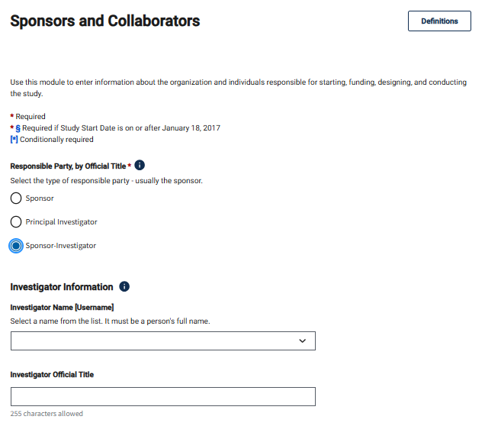
Requirements if Investigator holds the IND/IDE
Responsible Party:
RESPONSIBLE PARTY:
Select Sponsor-Investigator if study has an IND/IDE held by the PI
Investigator Official Title should reflect their role: Principal Investigator
Guidance for Sponsor and Collaborators continues on next slide
Notes:
Responsible Party
The Responsible Party is responsible for verifying the accuracy of a study record and releasing it to ClinicalTrials.gov. At UCSF, the Responsible Party is designated as follows for Investigator-Initiated Trials:
“University of California, San Francisco” should be listed as the Sponsor and Responsible Party in most cases unless the Principal Investigator (PI) holds an Investigational New Drug Application (IND) or an Investigational Device Exemption (IDE) for the Clinical Trial.
If the PI holds an IND/IDE for the Clinical Trial (as the “Sponsor-Investigator”), the PI should be listed as the Sponsor and Responsible Party.
Sponsor
At UCSF, when an Investigator-Initiated Trial is conducted under an investigational new drug application (IND) or investigational device exemption (IDE), the IND or IDE holder is considered the sponsor. When an Investigator-Initiated Trial is not conducted under an IND or IDE, UCSF is considered the sponsor.

Slide 25
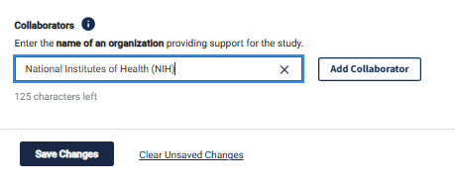
Collaborators
"Save Changes" button is at bottom of each section
If the study is NIH funded, you must include the NIH Institute or Center as a Collaborator.
Collaborators include funders, etc.
Add as many as necessary.
Notes:
Any federal grant/funding number(s) must be listed as a “Secondary ID” in the study record.

Slide 26
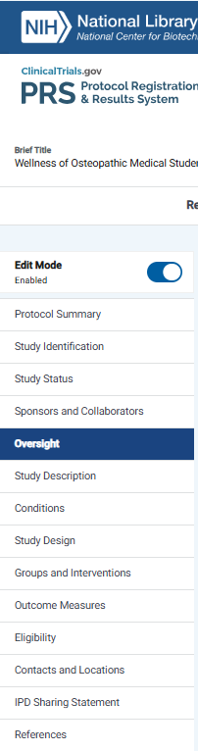
Oversight Section
Click the Definitions link for all definitions related to each Section
Click on this icon for information specific to the data element.

Slide 27
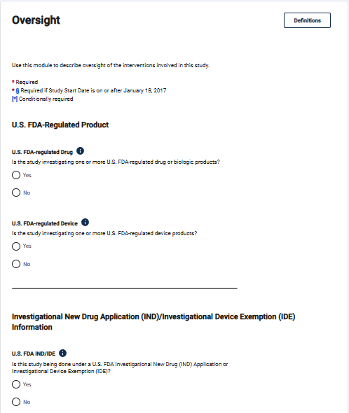
Oversight Section
Access a checklist for U.S. FDA-Regulated Drug or Device. By clicking Icon and then "Additional Information"
If this is “Yes”, more information about the device is needed [e.g., approval/clearance status, whether study can be posted to CT.gov prior to FDA approval/clearance, and whether the device is a pediatric postmarket surveillance of a device product]
If this is “Yes”, the IND/IDE information is required
Guidance for Oversight continues on next slide
Notes:
U.S. FDA-regulated Drug or Device? Indicate whether this study involves an FDA-regulated drug, biologic, or device:
Select ‘Yes’ if the study will be conducted under an IND or an IDE.
Select ‘Yes’ if the study will be conducted under an IND Exemption, IDE Exemption, or an NSR Determination.
Otherwise, select ‘No.’
U.S. FDA IND/IDE? Indicate whether this study will be conducted under an IND or IDE:
Select ‘Yes’ if the study will be conducted under an IND or IDE.
Select ‘No’ if the study does not have an IND or IDE.
Select ‘No’ if the study has an IND Exemption, IDE Exemption, or NSR Determination.

Slide 28
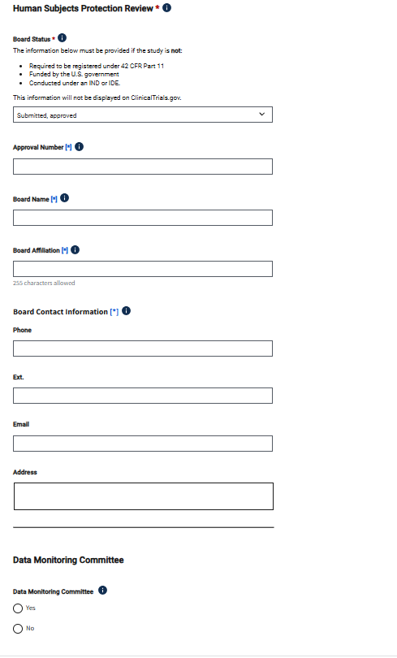
IRB
Registration before any enrollment begins is required at UCSF.
Human Subjects Protection Review
Board Status: IRB status
Approval Number: IRB study number
Board Name: Human Research Protection Program – Institutional Review Board
Board Affiliation: University of California, San Francisco
Board Contact Information
Phone: 415-476-1814
Email: IRB@ucsf.edu
Address: 490 Illinois Street, San Francisco, CA 94143
Enter these fields as shown to the right of this image
You must indicate whether a DMC has been appointed for this study

Slide 29
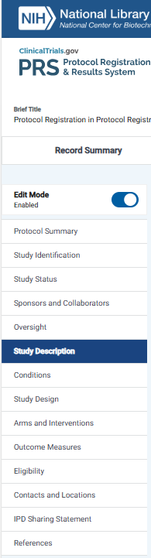
Study Description Section
Click the Definitions link for all definitions related to each Section
Click on this icon for information specific to the data element.

Slide 30
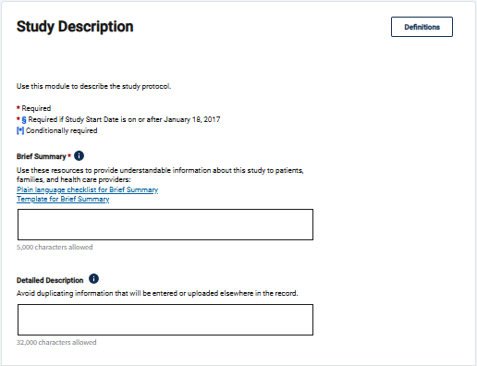
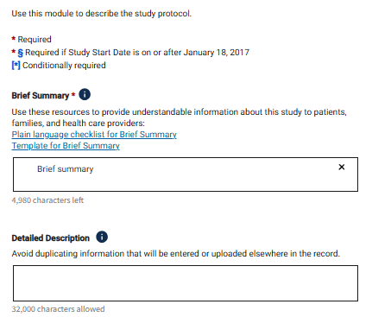
Study Description
Describe the study hypothesis in terms understandable to the lay public. It can be adapted from the informed consent, but omit all personal pronouns, (e.g., we, you, they).
SEE NEXT SLIDE FOR TEMPLATE and EXAMPLES
This field is optional and can be left blank. It does not have to be in lay language. It can be adapted from the background or aims section of the protocol, but do not copy and paste the entire protocol. This field cannot contain promotional language.
Where applicable, explain uncertainties or exploratory nature of study. If there are any parts of the trial, which the public cannot know about while the study is ongoing without affecting scientific integrity, such as deception research or inclusion/exclusion criteria which could be easily faked in order to join a study (e.g. pain levels in order to have access to a controlled substance), it would be good to explain here, e.g. “Some inclusion/exclusion criteria are purposely omitted at this time to preserve scientific integrity. They will be included after the trial is complete.”
Guidance for Study Description continues on next slide

Slide 31
Writing a Brief Summary
Template for writing a brief summary for the study overview
Use the template below as a guide to write a Brief Summary of a study in plain language.
Tailor the text that appears in brackets to your research study. To finalize, delete the text in italics if it doesn't apply to your study.
Brief summary template
The goal of this [study type: observational study or clinical trial] is to [primary purpose: e.g., learn if intervention or health behavior can treat, prevent, diagnose, etc.] in [describe participant population/primary condition; could include any of the following: sex/gender, age groups, healthy volunteers]. The main question[s] it aims to answer [is/are]:
[primary question, hypothesis, or outcome measure 1]
[primary questions, hypothesis, or outcome measure 2]
Participants will [describe the main tasks participants will be asked to do, interventions they'll be given and use bullets if it is more than 2 items].
If there is a comparison group: Researchers will compare [insert groups] to see if [insert effects].
Guidance for Study Description continues on next slide

Slide 32
Brief Description Example 1: Clinical Trial
The goal of this clinical trial is to learn if drug ABC works to treat severe asthma in adults. It will also learn about the safety of drug ABC. The main questions it aims to answer are:
Does drug ABC lower the number of times participants need to use a rescue inhaler?
What medical problems do participants have when taking drug ABC?
Researchers will compare drug ABC to a placebo (a look-alike substance that contains no drug) to see if drug ABC works to treat severe asthma.
Participants will:
Take drug ABC or a placebo every day for 4 months
Visit the clinic once every 2 weeks for checkups and tests
Keep a diary of symptoms and the number of times participants use a rescue inhaler
Guidance for Study Description continues on next slide

Slide 33
Brief Description Example 2: Observational Study
The goal of this observational study is to learn about the long-term effects of intervention A in women over the age of 60 who take intervention A to treat their rheumatoid arthritis (RA). The main question it aims to answer is:
Does intervention A lower joint pain in women over age 60 when taken long-term to treat RA?
Participants already taking intervention A as part of their regular medical care for RA will answer online survey questions about their joint pain for 5 years.
Guidance for Study Description continues on next slide

Slide 34
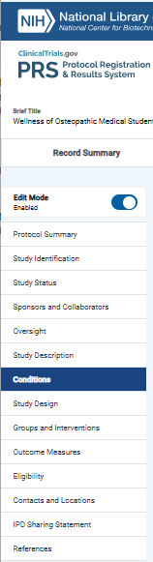
Conditions Section
Click the Definitions link for all definitions related to each Section
Click on this icon for information specific to the data element.

Slide 35
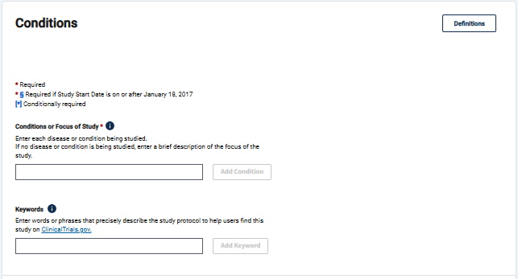
Conditions
Enter each study condition, one per line.
Use Search MeSH link to verify the correct condition term
Keywords help users find studies in the database

Slide 36
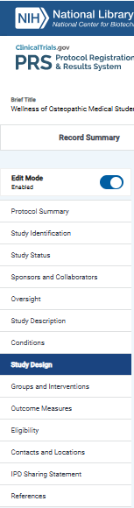
Study Design Section
Click the Definitions link for all definitions related to each Section
Click on this icon for information specific to the data element.

Slide 37
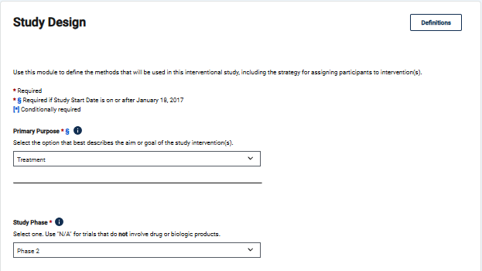
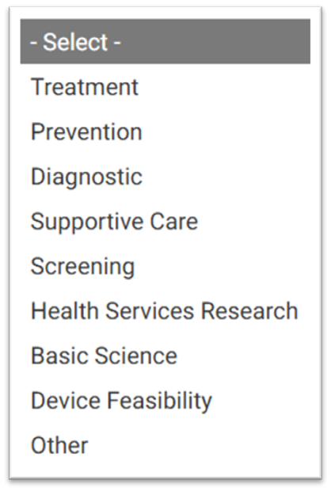
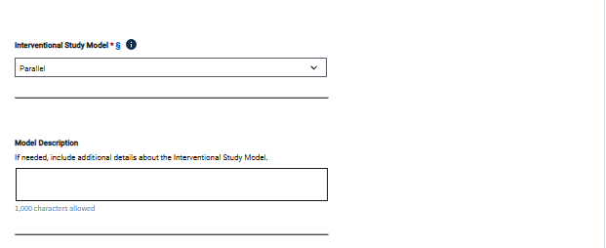
Study Design Section
Primary Purpose must be consistent with IRB and OnCore
Use "NA" for trials that do not involve drugs or biologics.
Guidance for Study Design continues on next slide

Slide 38
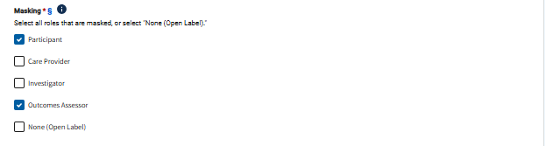
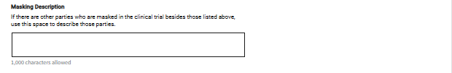

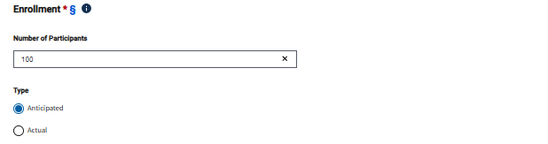
Masking
Allocation
Enrollment
Identify any individuals who will be blinded to the intervention
Identify if participants will be Randomized or not.
Give an honest estimate for anticipated enrollment (based on consent, not completion)

Slide 39
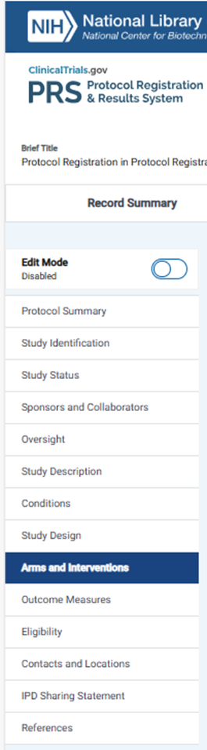
Arms and Interventions
Click the Definitions link for all definitions related to each Section
Click on this icon for information specific to the data element.

Slide 40
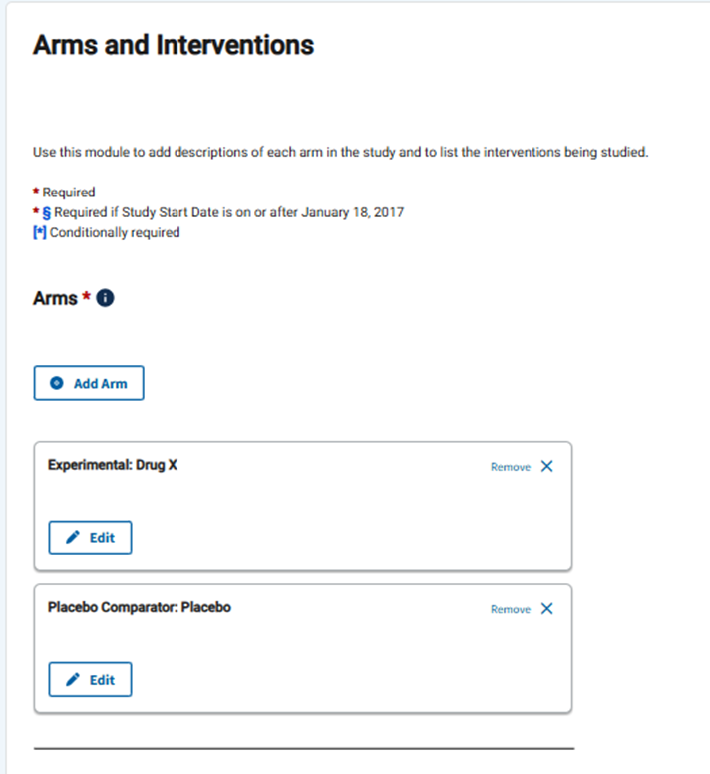
Arms and Interventions
Arms may not pre-exist based on how many arms you defined in the previous section.
You must add each arm, as necessary.
Click Edit to update Arm Title, Type and Description .
Guidance for Arm and Interventions continues on next slide

Slide 41
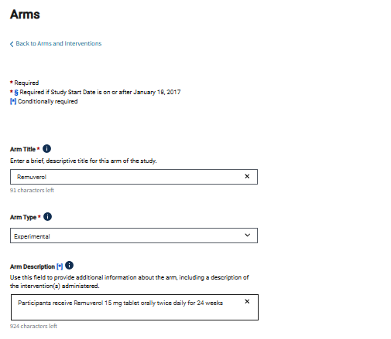
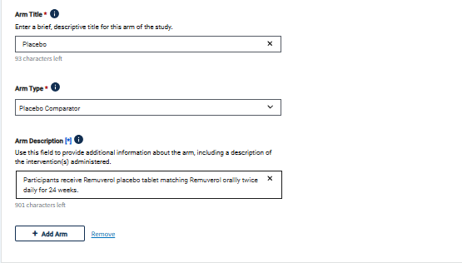
Arms: Interventions and Placebo (if applicable)
Do not title your arm as Intervention or Arm 1.
Arm title should be more descriptive.
Placebo should be identified as "Placebo Comparator
Guidance for Arm and Interventions continues on next slide

Slide 42
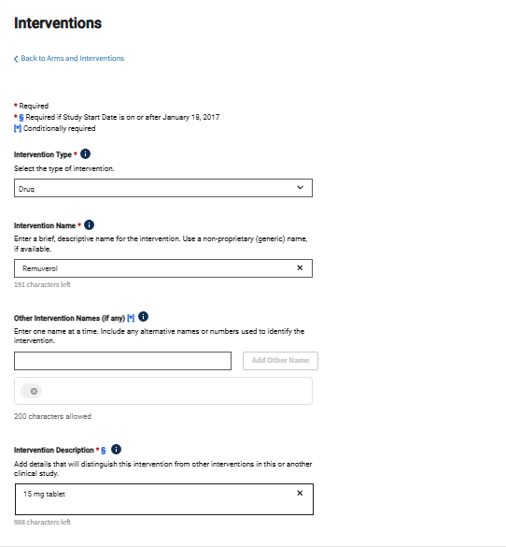
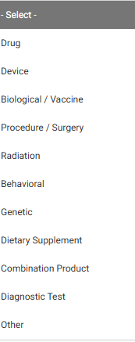
Interventions
Identify the Intervention Type
Guidance for Arm and Interventions continues on next slide

Slide 43
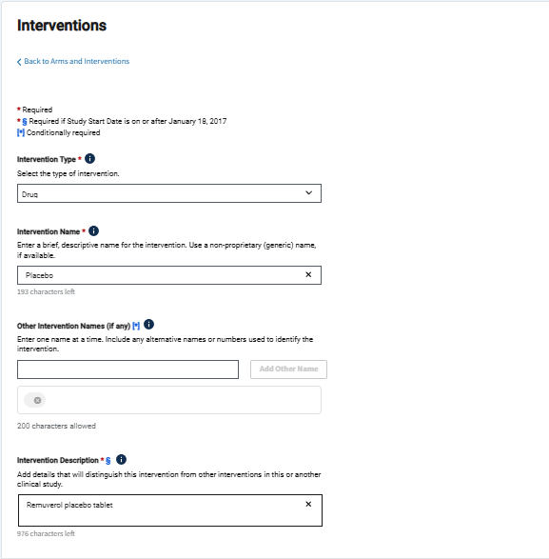
Intervention, continued
List Placebo as a Drug intervention, as applicable
Frequent PRS Comment: The preferred format is to include *all* interventions that were pre-specified to be administered as part of the protocol, even if a particular intervention is not "of interest“
Guidance for Arm and Interventions continues on next slide

Slide 44
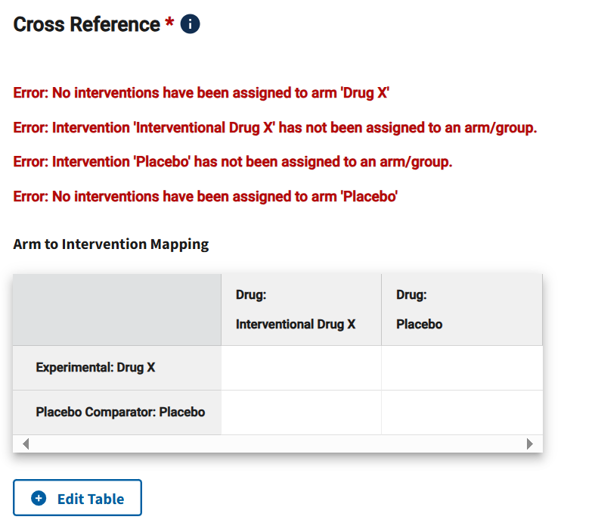
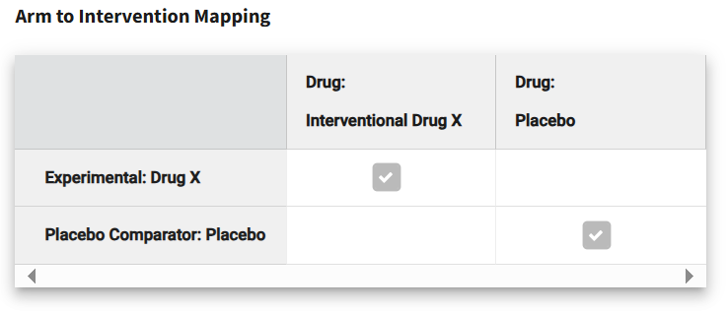
Cross Reference
Errors must be fixed.
Click Edit Table to resolve these Errors
Cross-Reference tables will not exist for single arm studies. For multiple arm studies, you must link arms and interventions even when it seems that it’s obvious that Arm A does intervention A and Arm B does intervention B.

Slide 45
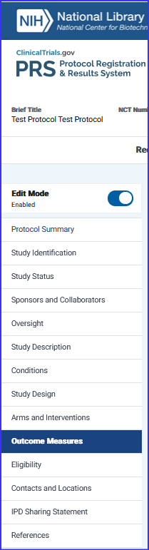
Outcome Measures Section
Click the Definitions link for all definitions related to each Section
Click on this icon for information specific to the data element.

Slide 46
Outcome Measures
Protocol/statistical analysis plan must be submitted with results and will be public for studies with a primary completion date of 1/18/2017 or later
Ensure coherence among protocol and registration for primary, secondary and “other” outcomes
PRS reviewers may assume all outcomes are primary or secondary unless specified in the protocol as other or exploratory
Protocol upload must contain a cover page with official title, NCT #, and version date
All Primary and Secondary outcomes are required (tertiary/exploratory are optional)
Label outcomes as “primary” or “secondary” per the protocol
Guidance for Outcome Measure continues on next slide
Notes:
42 CFR 11.10(a) Definitions:
Primary Outcome Measure: Outcome measure(s) of greatest importance specified in the protocol, usually the one(s) used in the power calculation
Secondary Outcome Measure: Outcome measure of lesser importance than primary outcome
Part of pre-specified analysis plan
Not specified as exploratory or other

Slide 47
Outcome Measures
More registrations get rejected for inadequate Outcome Measure precision or inaccurate or multiple time frames than anything else.
Outcome Measures should be specific and indicate what is being measured and is (or planned to be) reported.
Remember the mantra: Outcome Measures must be measurable outcomes.
Guidance for Outcome Measure continues on next slide
Notes:
An Example of the Four Levels of Specification in Reporting Outcome Measures: https://www.ncbi.nlm.nih.gov/pmc/articles/PMC3066456/figure/F1/
Zarin DA, Tse T, Williams RJ, Califf RM, Ide NC. The ClinicalTrials.gov results database—update and key issues. N Engl J Med. 2011;364(9):852-60.

Slide 48

Outcome Measure Tips: Title
Include the metric (i.e. scale, score, number, percentage)
Ex: Safety
Ex: Safety, as measured by number of subjects with at least one AE
Be clear and concise; omit verbs
Ex: To determine the maximum tolerated dose of Drug A in patients with breast cancer.
Ex: Maximum Tolerated Dose of Drug A in patients with breast cancer
List outcomes separately
Ex: All-cause mortality, hospitalizations, ER visits
Ex: Number of deaths, Number of hospitalizations, Number of ER visits Should be listed as 3 separate outcomes
Exception: if a composite score of multiple measures will be used
Example: Count of individuals who experience any of the following: all-cause mortality, hospitalizations, and emergency room visits
Guidance for Outcome Measure continues on next slide
Notes:
Tip: Enter WHAT will be measured, not why
It's important to note that this would be acceptable because they specify a score is being reported - if they simply listed this as "composite of all-cause mortality..." then reviewers will comment that this is multiple.

Slide 49
Outcome Measure Tips: Description
If a scale will be used, include the range and meaning of the scores
Example: The Hamilton Depression Rating Scale is used for rating the severity of depressive symptoms. Total score range is from 0 to 50, with higher scores indicating greater severity of depression.
If a scale is not linear (e.g. logarithmic), that would be good to note as well.
Guidance for Outcome Measure continues on next slide
Notes:
No longer optional

Slide 50
Outcome Measure Tips: Time Frame
Be specific (e.g. # of minutes, weeks, months)
Ex: Baseline, week 2
Ex: During hospitalization, approximately 5 days
Ex: Post-intervention, week 12
If multiple time points are included:
If measuring change between the time points, add the word “change” to the title
If not measuring change, each time point needs to be listed as a separate outcome measure
Remember that completion dates should reflect completion of data collection for your outcome measures. Refer to study status section.
Average time, expected average time, or max assessment time would all be acceptable when the protocol cannot specify precise time frame
Guidance for Outcome Measure continues on next slide
Notes:
For data that is collected and then analyzed at a later time point (for example, imaging), the time frames should usually be when the data were collected. So, if you are collecting CT images from a single CT, usually the length of the scan is an acceptable time frame.

Slide 51



Adding Outcome Measures
-Navigate to the Outcome Measures Section on the Protocol Tab.
-Make sure Edit Mode is enabled.
-Click to add outcomes.
Guidance for Outcome Measure continues on next slide

Slide 52


Outcome Measures: Example 1
There are 2 time points, so the word “change” is added to the title
The Title includes the scale that will be used to assess change in pain
The Description includes the range of the scale and what the scale means
Guidance for Outcome Measure continues on next slide
Notes:
NEW SCREEN SHOT FOR INDICATING

Slide 53


Outcome Measure: Example 2
The title includes the specific measurement that will be used and the metric for how the collected measurement will be aggregated.
The Description defines “outcome measure”. What information is being collected and how it is being collected.
The Time Frame includes the specific length of time. Specific time point(s) and overall duration of evaluation must be specified.

Slide 54

Eligibility Section
Click the Definitions link for all definitions related to each Section
Click on this icon for information specific to the data element.

Slide 55




Eligibility
Indicate whether people who do not have the disease or condition being studied are allowed to participate in the study.
Specify the criteria for participating in the study in a bulleted list under each category heading ("Inclusion Criteria" and "Exclusion Criteria").
Include only one item per bullet.
Make sure that all criteria you post are appropriate for the public to see.
Match informed consent more than protocol, if something might need to be masked from participants.
If necessary, use Detailed Description field to flag that the eligibility criteria are deliberately incomplete to preserve the scientific integrity of the study
S

Slide 56

Contacts and Locations Section
Click the Definitions link for all definitions related to each Section
Click on this icon for information specific to the data element.

Slide 57

Contacts: Central Contact
REQUIRED
Provide contact information for someone who can answer questions about enrolling in the study. Include:
Full name or official title
Phone number
Email address
*Do not use generic titles in place of a name (e.g., Study Coordinator or Principal Investigator)
Guidance for Contacts continues on next slide

Slide 58

Contacts: Backup
RECOMMENDED
Provide contact information for someone who can answer questions about enrolling in the study if the central contact is not available.
Guidance for Contacts continues on next slide

Slide 59

Contacts: Overall Study Official
REQUIRED
Provide information about the people who oversee the study protocol.
This field is required by the WHO and ICMJE.
Add the PI as a Study Official
Overall contact may be used to differentiate a study coordinator or administrator from the study official.
Organizational Affiliation:
Full name of the official's organization. If none, specify Unaffiliated.
Position or function of the official. Select one
Study Chair
Study Director
Study Principal Investigator
Guidance for Contacts continues on next slide

Slide 60



Locations:
All sites should be added for multi-site studies, only after the IRB has approved that location
Facility Information is required:
Provide complete location information for the facility.
State and ZIP code are required for U.S. locations, including U.S. territories.
Site recruitment status must be consistent with overall recruitment status;
if overall recruitment is not recruiting, no site can be recruiting
On"
Guidance for Locations continues on next slide

Slide 61

Locations: Facility Contact
Facility Information:
Provide contact information for someone who can answer questions about enrolling at this study location. Include:
Full name or official title
Phone number
Email address
A facility contact must be entered for each location if there is no central contact for the study.
Guidance for Contacts continues on next slide
Notes:
Alt Text: Screenshot of Facility Contact section under Contacts and Locations module of Protocol summary page. Read text in yellow box for definition and fill the data elements accordingly.

Slide 62

Locations: Facility Contact Backup
Facility Contact Backup:
Provide contact information for someone who can answer questions about enrolling in the study if the facility contact is not available.
Notes:
Alt Text: Screenshot of Facility Contact Backup section under Contacts and Locations module of Protocol summary page. Read text in yellow box for definition, and fill the data elements accordingly.

Slide 63

IPD Sharing Section
Click the Definitions link for all definitions related to each Section
Click on this icon for information specific to the data element.
Notes:
Alt text 1: Screenshot of the left-hand menu of the Protocol Summary page in the modernized PRS website for easy navigation.
Alt text 2: A screenshot to find the "definitions" link in the protocol summary sections.
Alt text 3: Screenshot to find the icon (i within a colored blue circle) for more information on data elements.

Slide 64
IPD Sharing Statement
The International Committee of Medical Journal Editors (ICMJE) requires that this information be included as part of trial registration for the results of studies to be published in ICMJE journals.
This policy applies to trials that began enrolling participants on or after January 1, 2019.
Applies to clinical trials that begin enrolling participants on or after January 1, 2019.
The statement must be in the original ClinicalTrials.gov registration.
The answer to “will data be available?” must be “No” or “Yes” (“Undecided” is not acceptable).
Per official ICMJE correspondence – even though ClinicalTrials.gov provides an “Undecided” option
The answer can change; explain in the Plan Description when updating the record.
Should match the data sharing statement required to be submitted (as of July 1, 2018) with the results manuscript for publication in ICMJE journals.
Guidance for IPD Sharing continues on next slide
Notes:
Indicate whether there is a plan to make individual participant data (IPD) collected in this study, including data dictionaries, available to other researchers (typically after the end of the study). IPD refers to deidentified participant-level data.
Select “Yes” or “No” only (“Undecided” is not acceptable).
Yes: There is a plan to make IPD and related data dictionaries available.
No: There is not a plan to make IPD available.
(Undecided: Do not select undecided, this is not accepted by ICMJE journals.)

Slide 65

Plan to Share IDP
Plan to Share IPD
Definition: Indicate whether there is a plan to make individual participant data (IPD) collected in this study, including data dictionaries, available to other researchers (typically after the end of the study). IPD refers to deidentified participant-level data. Select one.
Yes: There is a plan to make IPD and related data dictionaries available.
No: There is not a plan to make IPD available.
Undecided: Do not use this option, it will not be accepted by ICMJE journals.
All sharing of de-identified data needs to be reviewed in accordance with University of California, San Francisco’s policies and procedures and should not be done if it is deemed of a nature amounting to confidential business data.
Guidance for IPD Sharing continues on next slide
Notes:
Alt text:
Screenshot: "Plan to Share IPD" determination question if the respondent plans to share IPD with other researchers. There are three options to choose from: "Yes," "No," and "Undecided."

Slide 66
Plan to Share IDP
IPD Sharing Plan Description
Definition: If Plan to Share IPD is "Yes," briefly describe what specific individual participant data sets are to be shared (for example, all collected IPD, all IPD that underlie results in a publication). If the Plan to Share IPD is "No," an explanation may be provided for why IPD will not be shared.
If Plan to Share IPD is "Yes," provide the following information:
IPD Sharing Supporting Information Type
Definition: The type(s) of supporting information that will be shared, in addition to the individual participant data set and data dictionaries for the IPD itself. Select all that apply.
Study Protocol
Statistical Analysis Plan (SAP)
Informed Consent Form (ICF)
Clinical Study Report (CSR)
Analytic Code
Guidance for IPD Sharing continues on next slide

Slide 67
Plan to Share IDP
IPD Sharing Time Frame
Definition: A description of when the IPD and any additional supporting information will become available and for how long, including the start and end dates or period of availability. This may be provided as an absolute date (for example, starting in January 2025) or as a date relative to the time when summary data are published or otherwise made available (for example, starting 6 months after publication).
IPD Sharing Access Criteria
Definition: Describe by what access criteria IPD and any additional supporting information will be shared, including with whom, for what types of analyses, and by what mechanism. Information about who will review requests and criteria for reviewing requests may also be provided.
IPD Sharing URL
Definition: The web address, if any, used to find additional information about the plan to share IPD.
Guidance for IPD Sharing continues on next slide

Slide 68

IPD Sharing Statement Examples
Guidance for IPD Sharing continues on next slide

Slide 69

References Section
Click the Definitions link for all definitions related to each Section
Click on this icon for information specific to the data element.

Slide 70

References
During registration, citations should be obtained from the protocol. This is optional.
List citations for publications that provide background on this study's protocol or report results for this study.
Provide links to websites that give general information about the study.
Describe how to access individual participant data sets and any supporting information.
Guidance for References continues on next slide

Slide 71




Data Elements
Notes:
Links – Enter links to websites that provide information that is directly related to the study protocol.

Slide 72
Completing the Record

Slide 73

The Record Summary
Notes:
Now we’ve gone through the entire record. The Record Summary page will show us which sections still need attention. Also remember to click the Spelling link to address spelling errors and unexpanded acronyms, which may result in PRS comments if not resolved.

Slide 74

System Validation and Review Dashboard
Errors must be addressed before releasing the record
Warnings indicate potentially serious issues that should be reviewed and addressed as needed
Notes indicate other potential issues; address as needed
When the Record Summary shows all "0", the PI should carefully review the record.
False statements are criminal under the regulations!
For new registrations, the PI should read each section carefully
Notes:
Now we’ve gone through the entire record. The Record Summary page will show us which sections still need attention. Also remember to click the Spelling link to address spelling errors and unexpanded acronyms, which may result in PRS comments if not resolved.

Slide 75

The Record Summary – Study User Information
Add any co-PIs who should have edit rights. The Record Owner can do this
The Record Owner is the primary contact for the record. Only an administrator can change the Record Owner
This study appears to be an ACT and is subject to federal regulations
Initial Release date displays on the public site. This is important for FDAAA and ICMJE
Notes:
Note: Whoever initiates the registration is automatically assigned as the Record Owner, but this can be changed if needed. At UCSF, the Principal Investigator (PI) of the study is the Record Owner for Investigator-Initiated Trials.

Slide 76

The Record Summary – to Complete

Slide 77
Responsible Party: Reviews, Approves, and Releases Record “University of California, San Francisco” should be the Sponsor and Responsible Party in most cases unless the Principal Investigator (PI) holds an Investigational New Drug Application (IND) or an Investigational Device Exemption (IDE) for the Clinical Trial.

Slide 78
What are the responsibilities relating to Review, Approve and Release of Information
When the Responsible Party is UCSF, Record Owners should only update the record and mark “Entry Complete” for the UCSF Regulatory Support Team to review, approve, and release to PRS.
When the Responsible Party is the Sponsor-Investigator (meaning IND/IDE holder), the Sponsor-Investigator must update the record, mark “Entry Complete”, approve the record, and release to PRS.
The Responsible Party is responsible for ensuring that the information to be disclosed is accurate and complete:
All fields should be complete.
All fields should be accurate.
All fields should be in lay language, where possible.
Guidance for Review, Approval and Release continues on next slide
Notes:
Responsible Party
The Responsible Party is responsible for verifying the accuracy of a study record and releasing it to ClinicalTrials.gov. At UCSF, the Responsible Party is designated as follows for Investigator-Initiated Trials:
“University of California, San Francisco” should be listed as the Sponsor and Responsible Party in most cases unless the Principal Investigator (PI) holds an Investigational New Drug Application (IND) or an Investigational Device Exemption (IDE) for the Clinical Trial.
If the PI holds an IND/IDE for the Clinical Trial (as the “Sponsor-Investigator”), the PI should be listed as the Sponsor and Responsible Party.

Slide 79

Access Record Details
To Access the Record, click the “Open” Link to the left of the record Protocol ID
Guidance for Review, Approval and Release continues on next slide
Notes:
Responsible Party
The Responsible Party is responsible for verifying the accuracy of a study record and releasing it to ClinicalTrials.gov. At UCSF, the Responsible Party is designated as follows for Investigator-Initiated Trials:
“University of California, San Francisco” should be listed as the Sponsor and Responsible Party in most cases unless the Principal Investigator (PI) holds an Investigational New Drug Application (IND) or an Investigational Device Exemption (IDE) for the Clinical Trial.
If the PI holds an IND/IDE for the Clinical Trial (as the “Sponsor-Investigator”), the PI should be listed as the Sponsor and Responsible Party.

Slide 80

Access Record Details
To Access the Record Details, click on the “Protocol” tab
Guidance for Review, Approval and Release continues on next slide
Notes:
Responsible Party
The Responsible Party is responsible for verifying the accuracy of a study record and releasing it to ClinicalTrials.gov. At UCSF, the Responsible Party is designated as follows for Investigator-Initiated Trials:
“University of California, San Francisco” should be listed as the Sponsor and Responsible Party in most cases unless the Principal Investigator (PI) holds an Investigational New Drug Application (IND) or an Investigational Device Exemption (IDE) for the Clinical Trial.
If the PI holds an IND/IDE for the Clinical Trial (as the “Sponsor-Investigator”), the PI should be listed as the Sponsor and Responsible Party.

Slide 81


Edit Record Details
To Edit the Record Sections, enable the Edit Mode
From the Protocol Summary view, view the entire record and update the content of each section by clicking the Edit button within each section and then navigating to a section in the left-hand navigation bar
Within each section, “Save Changes” if any edits have been made by clicking the button at the bottom of the section.
Guidance for Review, Approval and Release continues on next slide
Notes:
Responsible Party
The Responsible Party is responsible for verifying the accuracy of a study record and releasing it to ClinicalTrials.gov. At UCSF, the Responsible Party is designated as follows for Investigator-Initiated Trials:
“University of California, San Francisco” should be listed as the Sponsor and Responsible Party in most cases unless the Principal Investigator (PI) holds an Investigational New Drug Application (IND) or an Investigational Device Exemption (IDE) for the Clinical Trial.
If the PI holds an IND/IDE for the Clinical Trial (as the “Sponsor-Investigator”), the PI should be listed as the Sponsor and Responsible Party.

Slide 82

Approve for Release to Public Site
Once the review or edits are complete, navigate back to the “Record Summary”.
The Responsible Party of the study must click on the “Approve” and “Release” buttons for the study to go through review by the Protocol Registration and Results System Team (PRS).
“University of California, San Francisco” should be listed as the Sponsor and Responsible Party in most cases unless the Principal Investigator (PI) holds an Investigational New Drug Application (IND) or an Investigational Device Exemption (IDE) for the Clinical Trial.
Guidance for Review, Approval and Release continues on next slide
Notes:
Responsible Party
The Responsible Party is responsible for verifying the accuracy of a study record and releasing it to ClinicalTrials.gov. At UCSF, the Responsible Party is designated as follows for Investigator-Initiated Trials:
“University of California, San Francisco” should be listed as the Sponsor and Responsible Party in most cases unless the Principal Investigator (PI) holds an Investigational New Drug Application (IND) or an Investigational Device Exemption (IDE) for the Clinical Trial.
If the PI holds an IND/IDE for the Clinical Trial (as the “Sponsor-Investigator”), the PI should be listed as the Sponsor and Responsible Party.

Slide 83
Approve and Release Record:
This is a two (2) step process with multiple clicks.
First: Review and Approve record
Guidance for Review, Approval and Release continues on next slide
Notes:
Responsible Party
The Responsible Party is responsible for verifying the accuracy of a study record and releasing it to ClinicalTrials.gov. At UCSF, the Responsible Party is designated as follows for Investigator-Initiated Trials:
“University of California, San Francisco” should be listed as the Sponsor and Responsible Party in most cases unless the Principal Investigator (PI) holds an Investigational New Drug Application (IND) or an Investigational Device Exemption (IDE) for the Clinical Trial.
If the PI holds an IND/IDE for the Clinical Trial (as the “Sponsor-Investigator”), the PI should be listed as the Sponsor and Responsible Party.

Slide 84

Releasing the Record
Second: Release the record
Guidance for Review, Approval and Release continues on next slide
Notes:
Don’t forget to release the record once you’ve made your updates.
Responsible Party
The Responsible Party is responsible for verifying the accuracy of a study record and releasing it to ClinicalTrials.gov. At UCSF, the Responsible Party is designated as follows for Investigator-Initiated Trials:
“University of California, San Francisco” should be listed as the Sponsor and Responsible Party in most cases unless the Principal Investigator (PI) holds an Investigational New Drug Application (IND) or an Investigational Device Exemption (IDE) for the Clinical Trial.
If the PI holds an IND/IDE for the Clinical Trial (as the “Sponsor-Investigator”), the PI should be listed as the Sponsor and Responsible Party.

Slide 85


Releasing the Record, continued
You may be prompted to check a box to confirm that you have completed the actions and acknowledge that the information is correct to the best of your knowledge.
Click the “Yes, Release” button to release record for review.
Once Released, the study will go through PRS review, which may take 2-5 business days or up to 30 days for updates with results.
Notes:
You may be asked to check a box confirming that you’ve completed all required actions and that the information provided is accurate to the best of your knowledge. To proceed, click the “Yes, Release” button to submit the record for review. Once submitted, the study will undergo PRS review, which typically takes 2–5 business days, but may take up to 30 days if the update includes results.
Responsible Party
The Responsible Party is responsible for verifying the accuracy of a study record and releasing it to ClinicalTrials.gov. At UCSF, the Responsible Party is designated as follows for Investigator-Initiated Trials:
“University of California, San Francisco” should be listed as the Sponsor and Responsible Party in most cases unless the Principal Investigator (PI) holds an Investigational New Drug Application (IND) or an Investigational Device Exemption (IDE) for the Clinical Trial.
If the PI holds an IND/IDE for the Clinical Trial (as the “Sponsor-Investigator”), the PI should be listed as the Sponsor and Responsible Party.

Slide 86
Additional Information
Deleting Records
PRS Review
Ongoing Responsibilities of Record Owners
Checking your Problem Records
Do You Need to Submit Results?

Slide 87
Can a Study Record be Deleted?
Only if the study record has never been released on ClinicalTrials.gov
ClinicalTrials.gov serves as a long-term public registry. Once a study record is registered and published (NCT number is assigned), it remains in the system even after a trial has closed.
If you find a duplicate, contact ClinicalTrials.gov at register@clinicaltrials.gov.

Slide 88
PRS Review
Once the record is released, ClinicalTrials.gov (PRS Staff) conducts a manual review
If Major Issues are identified, the record owner and RP will receive notification from ClinicalTrials.gov with comments
The study will be reset to In Progress
Study Owner/RP must correct the issues and re-release it within 15 calendar days
If no major issues are identified, the study is assigned an NCT number and published on the public side of the database (clinicaltrials.gov)
This process takes about 2-5 business days
Even if its published, advisory comments may be posted.
Corrections are not mandatory

Slide 89
Ongoing Responsibilities of Record Owners
Record owners must be the PI of record on the IRB application.
Records must be updated
Every 6 Months, if recruitment is active
Every 12 months, if not actively recruiting
Within 30 days of Recruitment Status changes or amendments that affect information in the ClinicalTrials.gov record, especially recruitment status, location, and contact information
Always update the Record Verification Date to indicate that the record has been updated or reviewed
Records must be updated within 30 days after the completion date (last data collection)
Failure to update information on ClinicalTrials.gov can result in penalties. There are more specific update requirements in 42 CFR 11.64 for device and drug studies.

Slide 90

Checking your Problem Records
PRS System identifies current
‘Problem Records’
Records that have not been marked as completed
Active studies that have not been updated (or the Record Verification Date has not been updated)
Records missing one or more FDAAA-required data elements:
Responsible Party
Study Start Date
Primary Completion Date
Primary Outcome Measure
Records that appear to be overdue for FDAAA results reporting
Notes:
Additionally, RPs and Record Owners will receive emails every 6 months about records with Problems. Lack of updating of the Verification Date is a very common problem.
The UCSF Office of Ethics and Compliance also sends regular emails about problem records to ensure compliance with your ClinicalTrials.gov study record, using PROCoM (developed at UCLA).

Slide 91


Do You Need to Submit Results?
All Applicable Clinical Trials (ACTs) are required to submit results
All NIH-funded trials begun on after 1/18/2017 must report results (ACTs and non-ACT)
Other grantors/funding agencies may require results submission
Based on registration information entered, the system will assess whether the trial appears to be:
An ACT with results required by law (as noted in image)
A Non-ACT: results ARE NOT required by law, though NIH policy (if so funded) or other funders’ policies may still require results reporting
Older trials may be designated Probable ACT or Probable Non-ACT
Note: There is no reminder flag for NIH-funded trials.
Notes:
Based on the information entered during trial registration, the system will evaluate and categorize the study as one of the following:
- An Applicable Clinical Trial (ACT) for which results reporting is legally required (as illustrated in the image). - A Non-ACT, where results are not legally mandated; however, reporting may still be required by NIH policy (if funded by NIH) or by other funders' policies. - For older trials, the system may label them as "Probable ACT" or "Probable Non-ACT" based on available data.
Note: The system does not generate reminder flags for NIH-funded trials.

Slide 92
Acknowledgements for Classic PRS Guide
The original slide set was developed collaboratively by contributors from
Beth Israel Deaconess Medical Center,
Boston University
Cambridge Health Alliance
Duke University
Fred Hutchinson Cancer Research Center
Harvard University
Mayo Clinic
Partners
Rutgers State University
University of Michigan
University of Pittsburgh
University of South Florida
Special thanks to:
Isabel Chico Calero
Niem Tzu Chen
Melanie Chladny
Wendy Duncan
Patrick Fawcett
Eleanor R. Greene
Jessica Houlihan
Odette Lobo
Linda Mendelson
Cynthia Monahan
Carolyn Peterson
Diane Wilson

Slide 93
Acknowledgement for Modernized PRS Guide
This slide set was developed collaboratively by contributors from​ and special thanks to:
Christina Barone, Yale University
N. Rebecca Chen, Rutgers University​
Cristina Ferrazzano Yaussy, Dartmouth Health
Susan Hmwe, City of Hope National Medical Center
Tony Keyes, Johns Hopkins University
Sharla Miles, Sam Houston State University​

